Slide 1
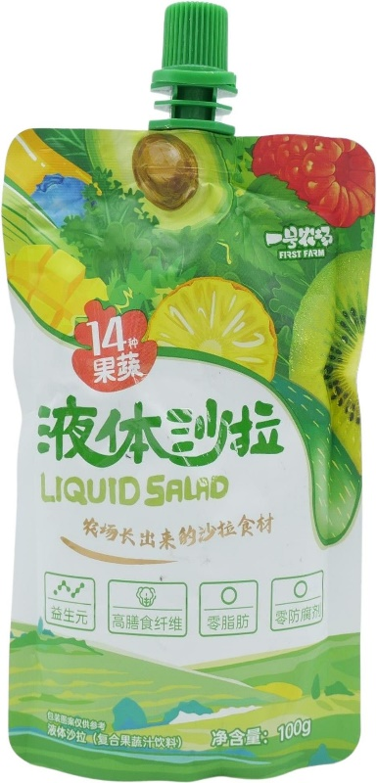
First Farm
Liquid Salad Compound Fruit and Vegetable Juice
This concept began its prominence in early 2024, when it received more attention on social media. Companies such as You Le Quan Biotechnology and Yi Hao Farm Technology launched liquid salad products containing at least 10 fruit and vegetable ingredients, and high nutrient content. The product is high in dietary fibre, and contains a minimum of 40% NFC fruit and vegetable juice.
Yi Hao Farm Technology, China
China
First Farm
$2.07

Slide 2
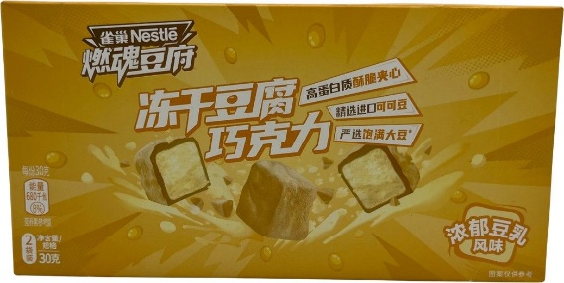
Nestlé Ran Hun Dou Fu
Rich Soy Milk Flavoured Freeze-Dried Tofu Chocolate
Nestlé Freeze-Dried Tofu Chocolate presents a new and unexpected ingredient pairing. Made using soybeans sourced from Northeast China and imported cocoa butter, the chocolate is described as featuring a crunchy filling with a delicate and smooth mouthfeel.
Nestlé, China
China
Nestlé Ran Hun Dou Fu
$2.79

Slide 3
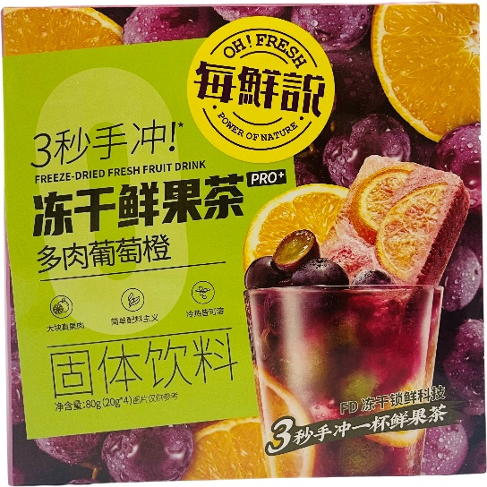
Oh! Fresh
Fleshy Grape and Orange Freeze-Dried Fresh Fruit Drink
Oh! Fresh Fleshy Grape and Orange Freeze-Dried Fresh Fruit Drink has large real fruit chunks and contains 51% juice content. It is processed with freeze-drying technology to lock in the freshness at -30°C. The product can be dissolved in cold or hot milk.
Oh! Fresh Food Technology, China
China
Oh! Fresh
$8.44

Slide 4
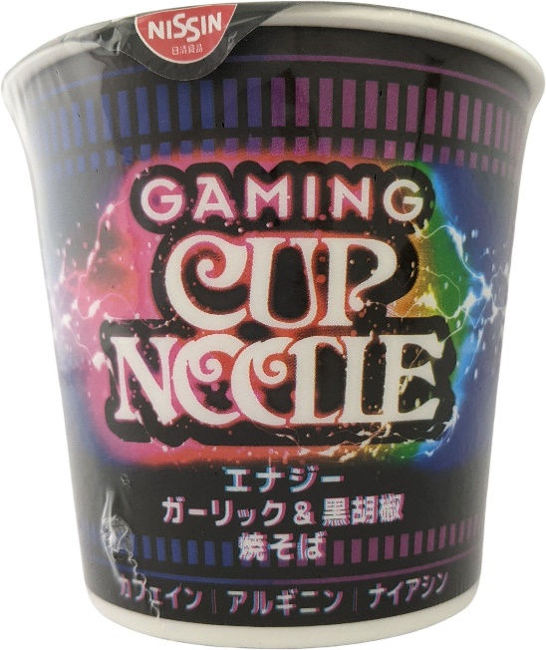
Nissin Gaming Cup Noodle
Energy Garlic & Black Pepper Chow Mein Noodles
Noodles that contain caffeine, arginine and niacin to help gamers stay 'buff'. Buff is a gaming terms descibing a gamers strength for attack power, defense power, resilience and movement within the game. The noodles are Yakisob and not Ramen as the liquid creates a sauce and not a broth to avoid gamers getting messy hands and spilling liquid.
Nissin Food Products, Japan
Japan
Nissin Gaming Cup Noodle
$2.38

Slide 5
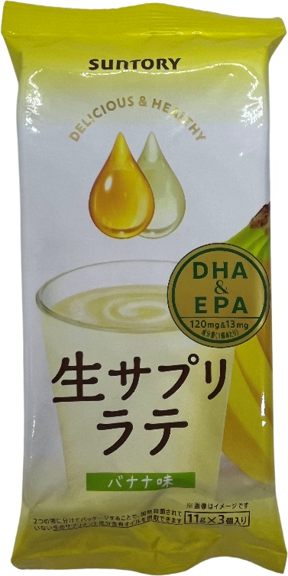
Suntory Nama Sapuli Latte
Banana Drink Mix with DHA & EPA
The drink comes with packets that consists of two parts of non-heat-treated oil with supplementary nutrition. It can be prepared by mixing with 100ml of white milk. The product contains 120mg DHA, and 13mg EPA per unit.
Suntory Foods, Japan
Japan
Suntory Nama Sapuli Latte
$3.76

Slide 6
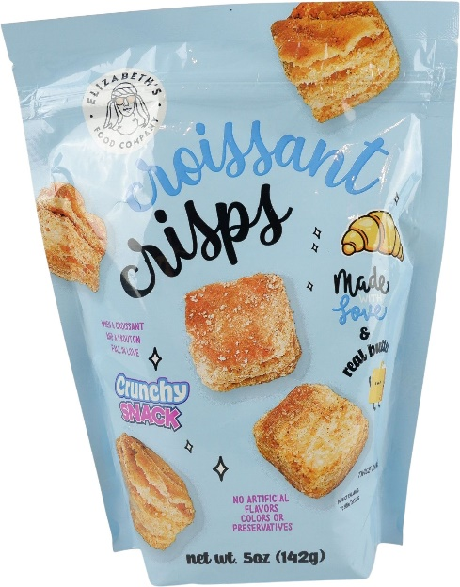
Elizabeth's Food Company
Croissant Crisps
This new crunchy snack claims when a croissant and a crouton fall in love. It is twice baked and made with love and real butter. The product is free from artificial/added flavors, colors or preservatives.
Elizabeth's Food Co., USA
USA
Elizabeth's Food Company
$2.81

Slide 7
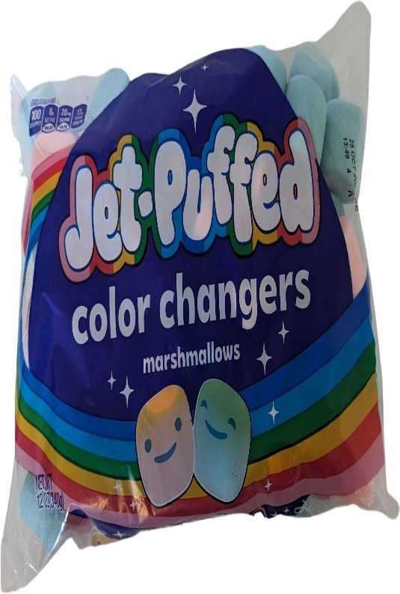
Jet-Puffed
Color Changers Marshmallows
Jet-Puffed Color Changers Marshmallows change color when they come into contact with heat. This offers a unique experience to consumers. The product also appeals to consumers' desire for foods that offer an aesthetic component.
Kraft Heinz Foods, USA
USA
Jet-Puffed
$2.99

Slide 8
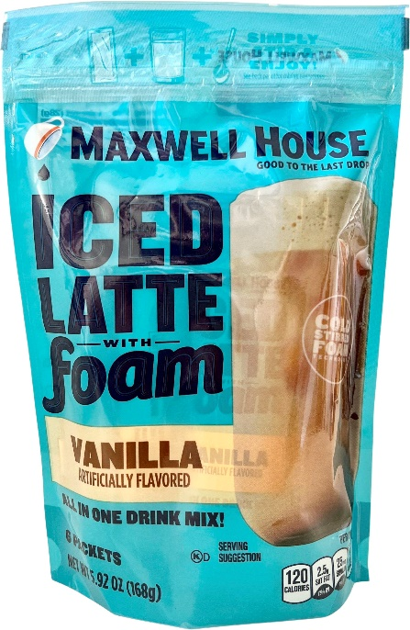
Maxwell House
Vanilla Iced Latte with Foam All in One Drink Mix
This coffee mix offers cafe style cold coffee at home tapping into booming consumer demand for iced coffee (driven by Gen Z and millennials) but in an affordable format. Cold stirred foam technology creates a creamy, café-style beverage without the need for special equipment
Kraft Heinz Foods, USA
USA
Maxwell House
$4.15

Slide 9
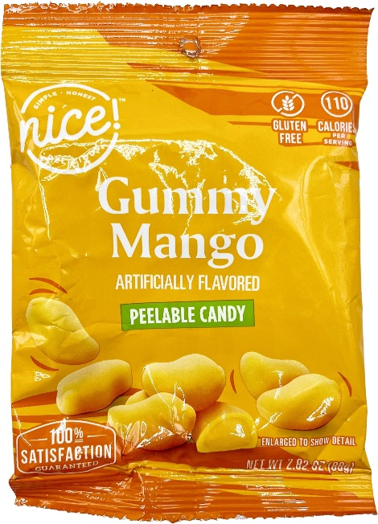
Nice!
Will Grand Slam
Walgreen’s peelable candy contains creative uses of texture amp up the indulgence factor. Although it is gluten free and includes low/no/reduced allergen, it is indeed artificially favoured.
Walgreen, USA
USA
Nice!
$1.79

Slide 10
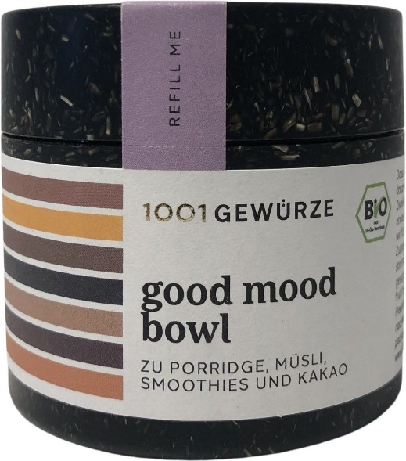
1001 Gewürze
Good Mood Bowl Seasoning Mix
1001 Gewürze Good Mood Bowl Gewürzmischung has been repackaged, and retails in a newly designed 60g pack. It is designed for porridge, muesli, smoothies, fruit bowls and cocoa. The environmentally friendly package highlighting refilling and sustainability, with EU Organic, BIO-Siegel (Bio Seal) certification.
1001 Gewürze, Germany
Germany
1001 Gewürze
$15.65

Slide 11
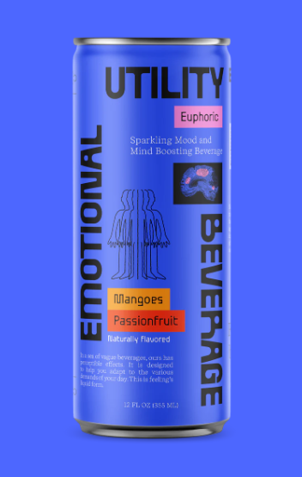
E.U.B. Euphoric
Emotional Utility Beverage Mangoes & Passionfruit
Mangoes Passionfruit is a tropical blend of juicy mangoes and tart passionfruit. Formulated to produce an uplifting, euphoric effect. E.U.B. Beverages contain Amino Acids, Adaptogens, Nootropics, and B-Vitamins that support the firing, blocking, and regulating of key excitatory, inhibitory, and modulatory Neurotransmitters such as GABA, serotonin, dopamine, endorphins etc.
Emotional Utility Beverage, USA
USA
E.U.B. Euphoric
$3.49

Slide 12
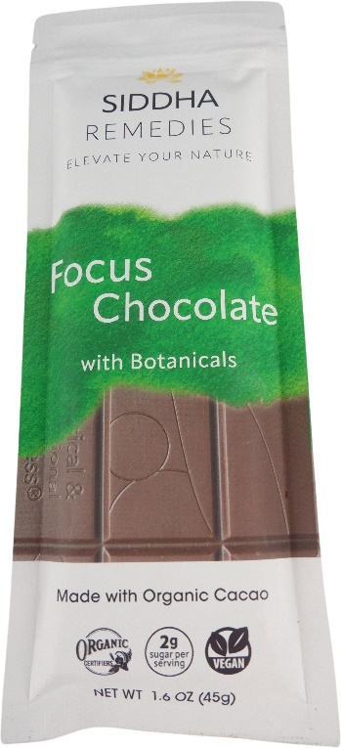
Siddha Remedies
Focus Chocolate with Botanicals
Various botanical blends offer a boost, allowing consumers to choose products based on current (or desired) mood. It has protein crisp topping, 2g sugar per serving, 2g coconut sugar, and 7g dietary fiber. It includes 64% cacao, 96% organic ingredients, and 0% gluten, stevia, dairy.
Siddha Remedies, USA
USA
Siddha Remedies
$12.32

Slide 13
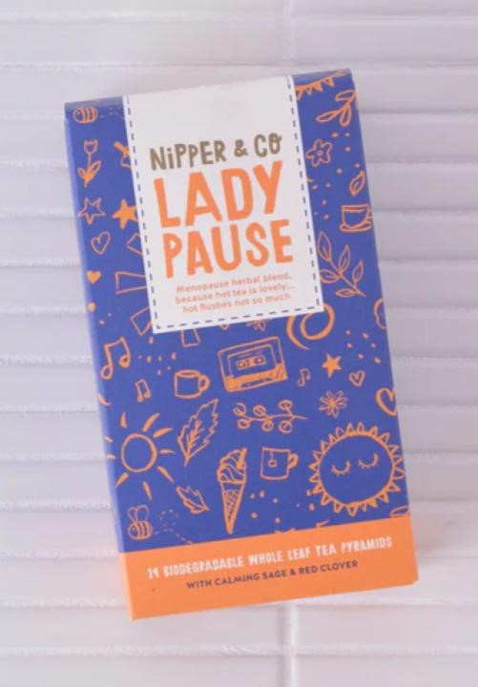
Lady Pause!
Woman's Menopause and Perimenopause herbal infusion
This 100% natural powerful herbal infusion of botanicals that have been used for centuries to support women in all phases of menopause. From hot flushes, night sweats to mood swings and sleep problems, we have you covered.
Nipper&Co, UK
UK
Lady Pause!
$9.38

Slide 14
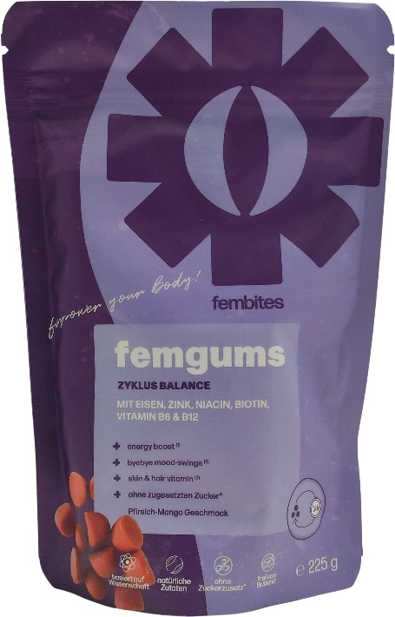
Fembites
Femgums for Cycle Balance
Fembites Femgums Zylus Balance (Femgums for Cycle Balance) is said to power one's body with iron, zinc, niacin, biotin, vitamin B6 and B12. Provide Energy boost, helps manage mood swings, and nurture skin and hair with various types of vitamin and natural ingredients.
Fembites, Germany
Germany
$32.78

Slide 15
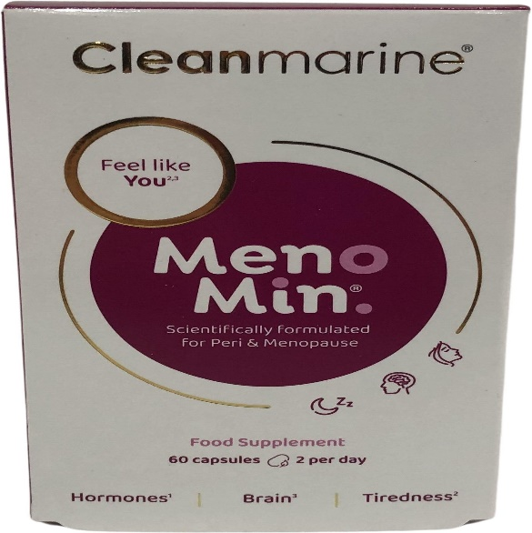
Cleanmarine MenoMin
Food Supplement Scientifically Formulated for Peri & Menopause
Cleanmarine MenoMin. Food Supplement is a scientifically formulated Omega-3 and multi-vitamin blend for people aged 40+ during peri-menopause or menopause. Also, MenoMin provides daily nutritional support during this natural life stage.
Savant Distribution, UK
UK
Cleanmarine MenoMin.
$57.53

Slide 16
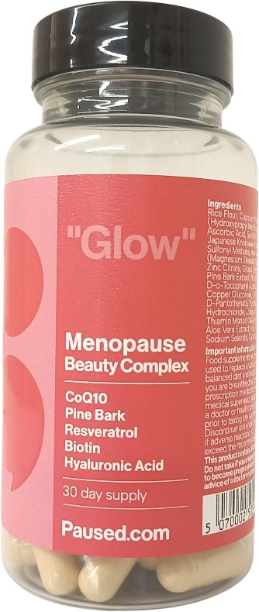
Paused.com
Glow" Menopause Beauty Complex Capsules
This 100% natural powerful herbal infusion of botanicals that have been used for centuries to support women in all phases of menopause. From hot flushes, night sweats to mood swings and sleep problems, we have you covered. Perfect as everyday woman's cuppa.
Paused, UK
UK
Paused.com
$27.82

Slide 17
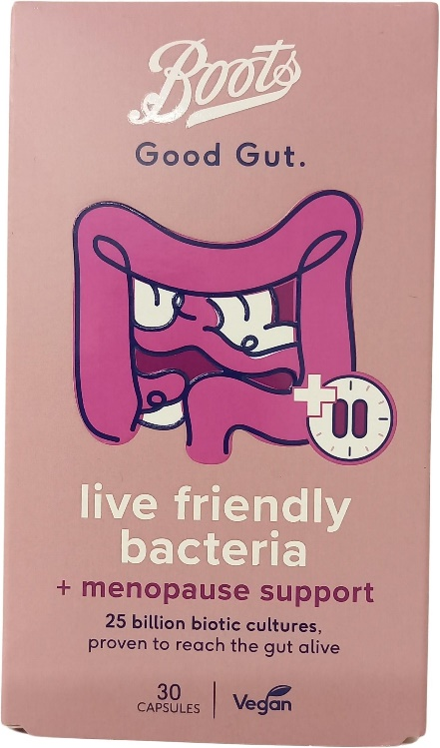
Boots Good Gut.
Live Friendly Bacteria + Menopause Support Capsules
Contains billions and billions of biotic cultures, ashwaghanda extract and soy isoflavones, plus an expert blend of vitamins designed to give the gut a helping hand throughout menopause. Each capsule contains a blend of B vitamins and magnesium to support energy levels, calcium plus vitamin D and K for triple action bone support, and vitamin B6 for hormonal support tailored for an individual menopause journey.
The Boots Company, UK
UK
Boots Good Gut
$17.51

